Slide 1

INTRODUCTION TO STATISTICAL DATA ANALYSIS USING R & RSTUDIO LUMUMBA WANDERA VICTOR (M.Sc. Applied Statistics) 9th March, 2026

Slide 2
OVERVIEW
This session introduces two of the most fundamental tools used in statistical analysis: correlation and regression analysis. These techniques are used to explore and quantify relationships between variables in a dataset.
In many real-world applications such as health sciences, economics, engineering, and social sciences, researchers are interested in understanding whether one variable influences another.
In this session, we will learn how to identify relationships between variables, quantify the strength of these relationships, and build predictive models using the R programming language. We will also demonstrate these concepts using a real health dataset containing information related to hypertension

Slide 3
COURSE CONTEXT
This session is part of the course “Professional Certificate for Data Scientists using R and Rstudio.” In previous sessions, students were introduced to data types, descriptive statistics, and graphical visualization.
These foundational concepts are essential because regression and correlation analysis require a good understanding of how variables behave and how they are distributed.
In this session, we move beyond describing data to analyzing relationships between variables. The analysis will be conducted using R and RStudio, which provide powerful tools for statistical modeling and visualization.
The practical examples will utilize the dataset htn_dat.csv, which contains clinical information related to hypertension patients.

Slide 4
SESSIONA OBJECTIVES
By the end of this session, students should be able to understand the theoretical foundations and practical applications of correlation and regression analysis.
Specifically, students will learn how to measure the strength of relationships between variables and how to construct models that explain or predict outcomes based on predictor variables.
Learning objectives
🎯 Understand the difference between correlation and regression 🎯 Learn the historical development of regression analysis 🎯 Perform correlation analysis using R 🎯 Fit simple and multiple linear regression models 🎯 Interpret regression output including coefficients and p-values 🎯 Diagnose model assumptions using residual analysis
These skills are essential for data analysis, statistical research, and predictive modeling.

Slide 5
Why Statistics Before Machine Learning?
Machine Learning is applied statistics at scale.
Key statistical foundations:
Hypothesis testing for decision-making
Regression for prediction and inference
p-values and confidence intervals for uncertainty
Healthcare relevance in Kenya:
Logistic regression for hypertension risk prediction
Survival analysis for HIV treatment outcomes
Statistics ensures transparent and responsible AI
Key message:
Machine learning without statistics becomes a black box.

Slide 6
Learning Objectives
By the end of this session, you will be able to:
Formulate and test statistical hypotheses
Interpret regression coefficients correctly
Apply OLS regression for continuous outcomes
Apply logistic regression for binary outcomes
Evaluate models using R², accuracy, and AUC
Connect regression concepts to ML algorithms

Slide 7
Dataset Overview
Dataset: htn_dat.csv
Records: 4,900 patients from Kenyan health facilities
Outcome variables:
SBP (continuous systolic blood pressure)
SBP_ge120 (binary hypertension indicator)
Predictor variables:
Age, BMI, DBP
Gender, marital status
Urban clinic indicator
HIV and ART status
Research question:
Which factors significantly predict hypertension risk?

Slide 8
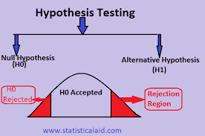
What is Hypothesis Testing?
Hypothesis testing evaluates claims about population parameters.
Null hypothesis (H₀):
No effect or no relationship
Alternative hypothesis (H₁):
An effect or relationship exists
Example:
H₀: BMI is not associated with hypertension
H₁: BMI is associated with hypertension

Slide 9
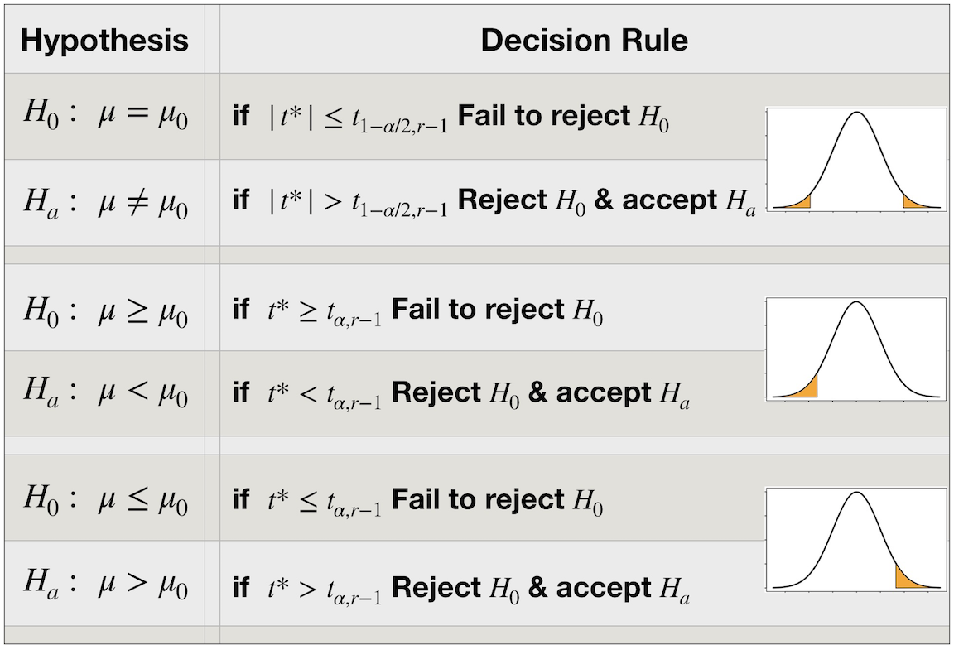
Decision Rule in Hypothesis Testing
Decision based on p-value:
p < 0.05 → Reject H₀
p ≥ 0.05 → Fail to reject H₀
Important principle:
We do not "accept" the null hypothesis.
We only reject or fail to reject it.

Slide 10
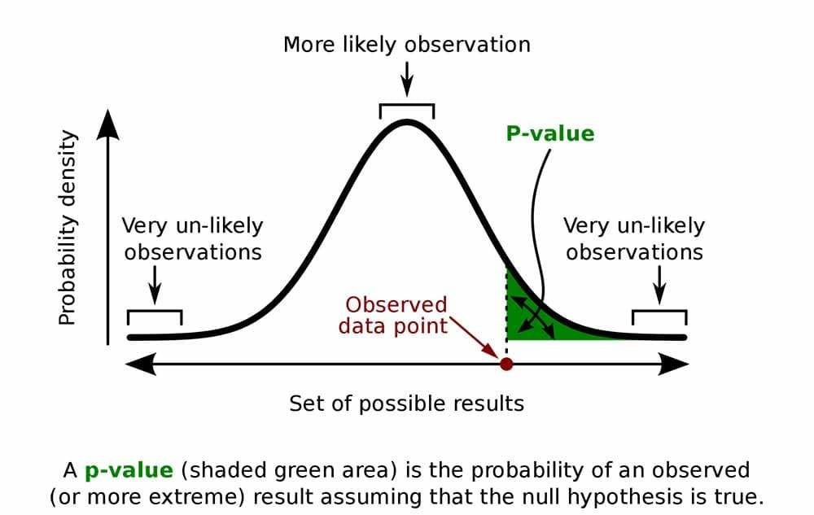
Understanding p-values
A p-value measures evidence against the null hypothesis.
Definition:
Probability of observing the data (or more extreme)
assuming the null hypothesis is true.
Interpretation:
Small p-value → Strong evidence against H₀
Large p-value → Weak evidence against H₀

Slide 11
Medical Example of a p-value
Hypothesis:
H₀: Mean SBP is equal in urban and rural clinics
H₁: Mean SBP differs between clinics
Result:
p = 0.003
p-value is compared with alpha (5% (0.05), 10%(0.1), 1%(0.01)
Interpretation:
There is strong evidence that clinic location is associated with systolic blood pressure.

Slide 12
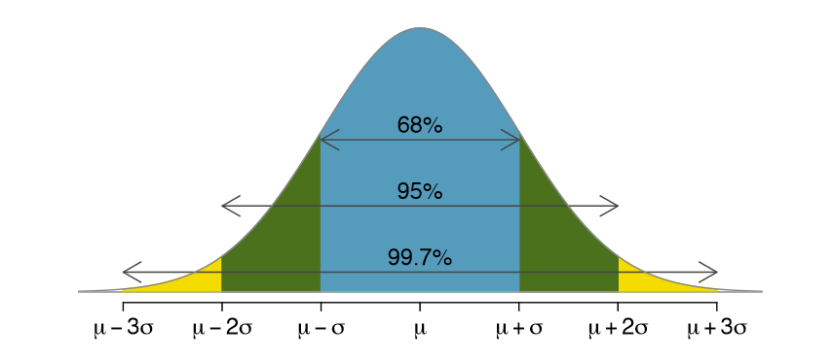
Confidence Interval
A confidence interval provides a range of plausible values for a population parameter.
95% confidence interval:
If the study were repeated many times, 95% of such intervals would contain the true value.
Confidence intervals show:
Effect size
Precision of estimates

Slide 13
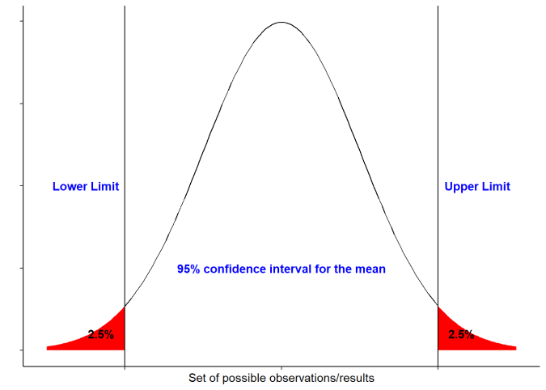
Confidence Interval Example
Mean SBP difference (urban – rural) = 4.2 mmHg
95% CI: [2.1, 6.3] mmHg
Interpretation:
The true SBP difference lies within this range
CI does not include zero → statistically significant
Provides more information than p-value alone

Slide 14
Choosing the Right Statistical Test
Test selection depends on variable types:
Two means → Independent t-test
More than two means → ANOVA
Two categorical variables → Chi-square test
Two continuous variables → Correlation
Continuous outcome → OLS regression
Binary outcome → Logistic regression

Slide 15
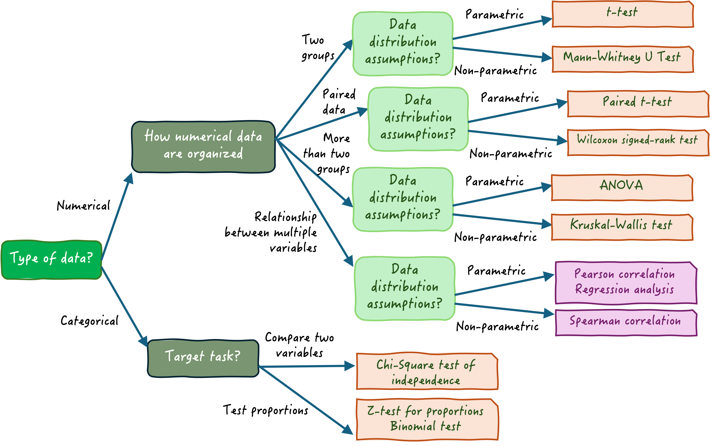

Slide 16
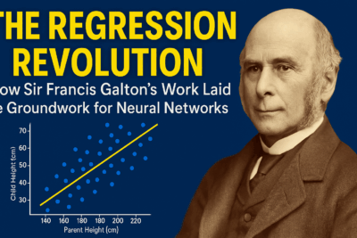
History of Regression
The concept of regression was first introduced by Sir Francis Galton in 1886 while studying the relationship between the heights of parents and their children. Galton observed that extremely tall parents tended to have tall children, but their children were usually slightly shorter than the parents.
Similarly, very short parents tended to have children who were short but not extremely short. Galton described this phenomenon as “regression toward mediocrity,” which later became known as regression toward the mean.
Historical milestones
👨‍🔬 Francis Galton (1886) – Introduced the concept of regression 📊 Karl Pearson – Developed correlation coefficient 📈 Udny Yule – Extended regression models
Today, regression analysis is widely used in statistics, econometrics, machine learning, and data science.

Slide 17
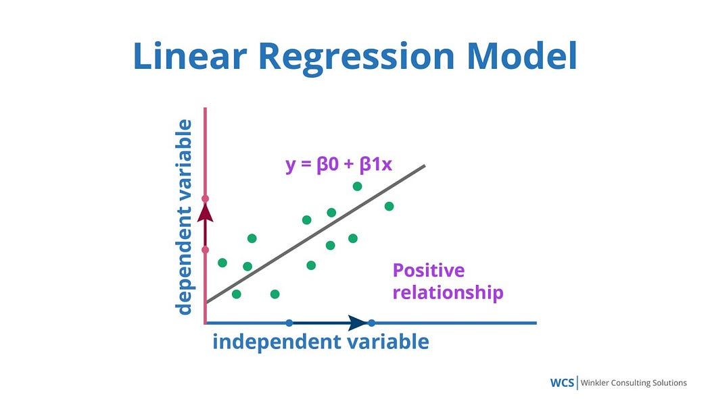
Introduction to Regression Analysis
Regression models the relationship between predictors (X) and an outcome variable (Y).
General form:
Y = β₀ + β₁X₁ + β₂X₂ + ... + ε
Regression is the foundation of many ML algorithms.

Slide 18
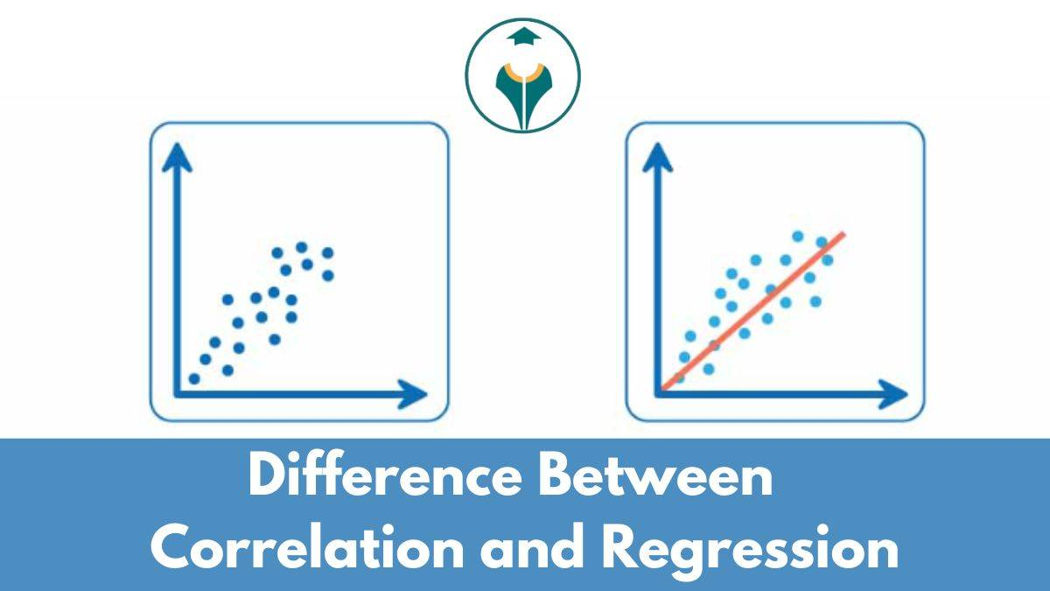
Correlation Vs Regression
Correlation and regression both analyze relationships between variables, but they serve different purposes.
Correlation measures the strength and direction of a linear relationship between two variables. However, it does not establish cause-and-effect relationships.
Regression analysis goes further by creating a mathematical model that predicts the value of a dependent variable based on one or more independent variables.
Key differences
Correlation
Measures strength and direction of association
Symmetric relationship (X and Y interchangeable)
Range: -1 to +1
Regression
Used for prediction and modeling
Distinguishes dependent and independent variables
Produces a mathematical equation
Understanding this distinction is essential for correct statistical interpretation.

Slide 19
The Dataset
The Dataset (htn_dat)
In this session, we will analyze a dataset related to hypertension (high blood pressure). Hypertension is a major global health concern because it increases the risk of heart disease, stroke, and kidney problems.
The dataset contains several clinical and demographic variables that may influence blood pressure.
Important variables
🫀 SBP – Systolic Blood Pressure (outcome variable) 🩺 DBP – Diastolic Blood Pressure ⚖️ BMI – Body Mass Index 🎂 Age – Age of patient 👨 male.gender – Gender indicator ⏱ survtime – Survival time
Our main goal is to investigate whether BMI and age influence systolic blood pressure.

Slide 20
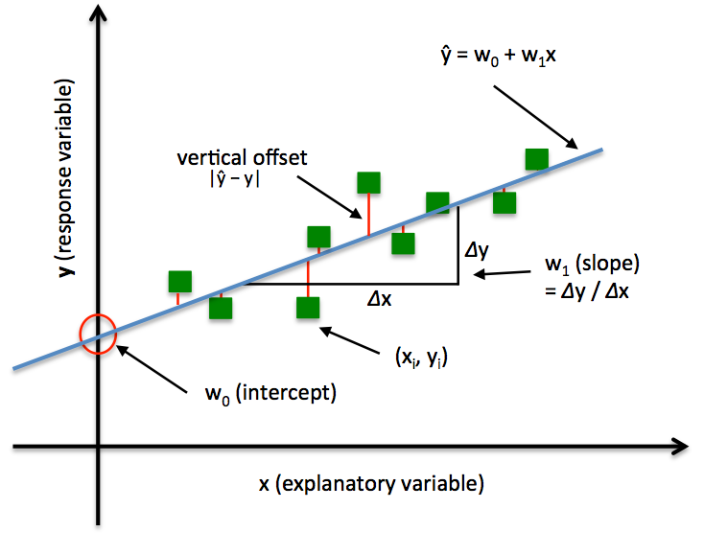
Ordinary Least Squares (OLS) Regression
OLS regression predicts continuous outcomes.
Medical application:
Predict systolic blood pressure using:
BMI
Age
Gender
OLS minimizes the sum of squared prediction errors.

Slide 21
Interpreting OLS Coefficients
Coefficient interpretation:
Sign (+/–): Direction of relationship
Magnitude: Size of effect
p-value: Statistical significance
Example:
A BMI coefficient of 0.87 means SBP increases by 0.87 mmHg per unit BMI increase, holding other variables constant.

Slide 22
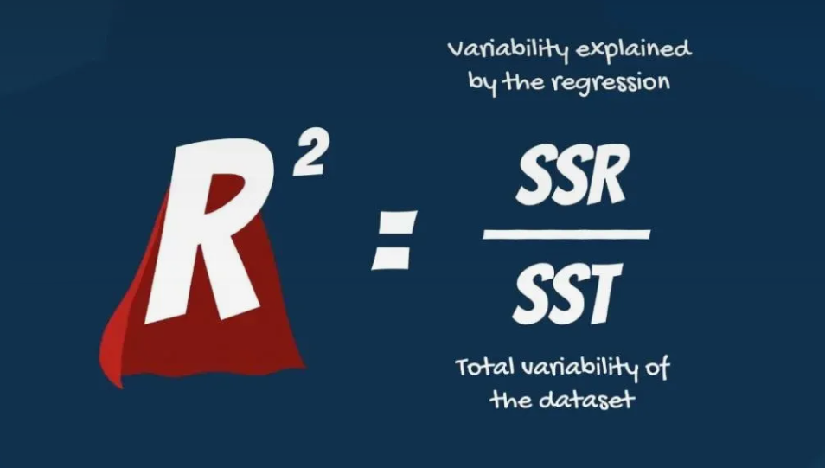
Model Fit in OLS Regression
Key evaluation metrics:
R²: Proportion of variance explained
RMSE: Prediction error magnitude
MAE: Average absolute error
R² does not imply causation, only explanatory power.

Slide 23
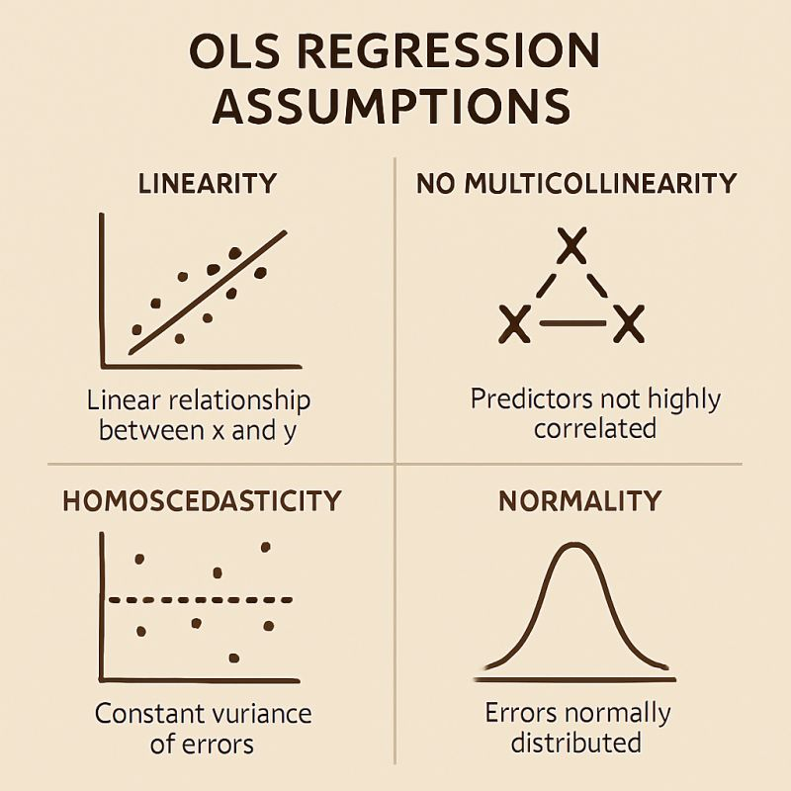
OLS Assumptions
OLS regression assumptions:
1. Linearity
2. Independence of observations
3. Homoscedasticity
4. Normality of residuals
5. No multicollinearity
Violations require transformations or alternative modeling approaches.

Slide 24
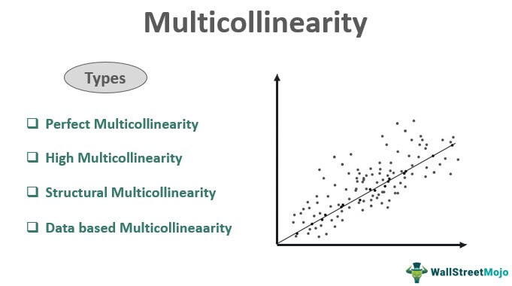
Multicollinearity
Multicollinearity is a statistical phenomenon in multiple regression where two or more independent variables are highly correlated.
This means that one can be linearly predicted from the others with a high degree of accuracy.
Effects:
It causes unreliable coefficients
Unstable coefficient estimates,
Makes it difficult to determine the individual effect of each predictor on the dependent variable.

Slide 25
Types Multicollinearity
High Multicollinearity: It signifies a high or strong correlation between two or more independent variables, but not a perfect one.
Perfect Multicollinearity: This degree of collinearity indicates an exact linear relationship between two or more independent variables.
Data-based Multicollinearity: The possibility of collinearity, in this case, arises out of the selected dataset.
Structural Multicollinearity: This issue arises when researchers have a poorly designed framework for the regression analysis.

Slide 26
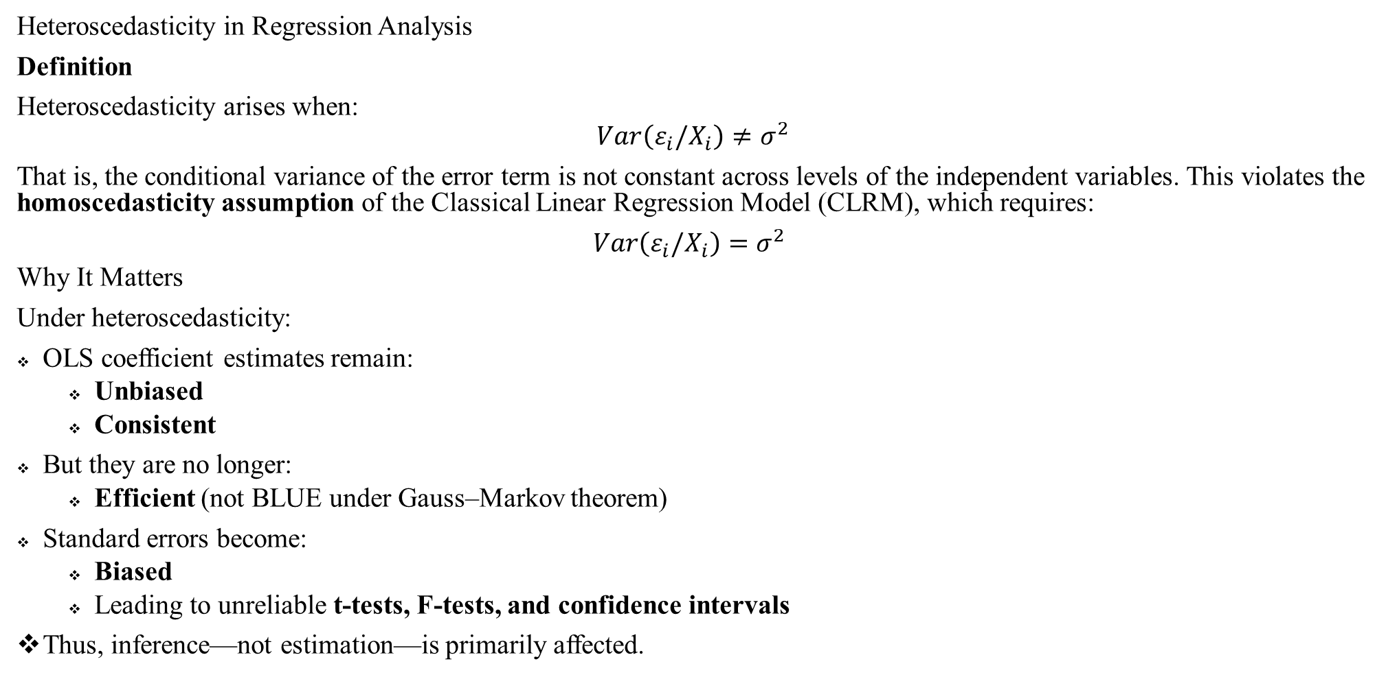
Heteroscedasticity
Heteroscedasticity in Regression Analysis
Definition
Heteroscedasticity arises when:
$$Var\left(ε_{i}/X_{i}\right)≠σ^{2}$$
That is, the conditional variance of the error term is not constant across levels of the independent variables. This violates the homoscedasticity assumption of the Classical Linear Regression Model (CLRM), which requires:
$Var\left(ε_{i}/X_{i}\right)=σ^{2}$
Why It Matters
Under heteroscedasticity:
OLS coefficient estimates remain:
Unbiased
Consistent
But they are no longer:
Efficient (not BLUE under Gauss–Markov theorem)
Standard errors become:
Biased
Leading to unreliable t-tests, F-tests, and confidence intervals
Thus, inference—not estimation—is primarily affected.

Slide 27
Heteroscedasticity
Common Causes
Scale effects Variability increases with magnitude (e.g., income and consumption).
Omitted variables Missing important predictors can create structured variance patterns.
Incorrect functional form Nonlinear relationships modeled as linear.
Outliers
Cross-sectional data Frequently exhibits non-constant variance.
Detection Methods
1. Graphical
Residuals vs. Fitted plot
Scale-Location plot Fan or cone-shaped dispersion indicates heteroscedasticity.
2. Statistical Tests
Breusch–Pagan test
White test
Goldfeld–Quandt test
Solutions
Robust Standard Errors (White/Huber-White)
Adjust inference without changing coefficients.
Transformation
Log or square-root transformation of dependent variable.
Weighted Least Squares (WLS)
Weights inversely proportional to error variance.
Model Re-specification
Include omitted variables or correct functional form.
Finance Perspective
In financial time series, heteroscedasticity appears as volatility clustering, where:
Large shocks follow large shocks.
Small shocks follow small shocks.
This conditional heteroscedasticity is modeled using:
ARCH models
GARCH models

Slide 28
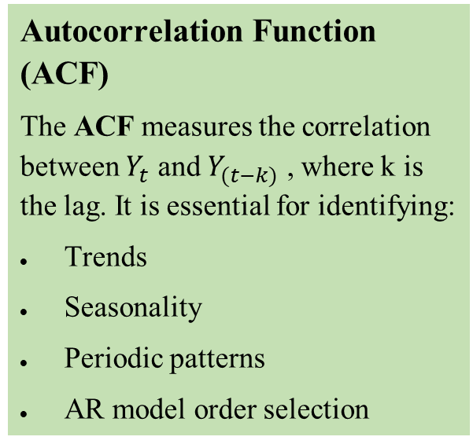
Autocorrelation
Autocorrelation (Serial Correlation)
Autocorrelation refers to the correlation between observations of the same variable at different points in time. In time series analysis, it measures the degree to which current values of a variable are related to its past values. The autocorrelation coefficient ranges from –1 to +1:
+1 → Perfect positive autocorrelation
–1 → Perfect negative autocorrelation
0 → No linear autocorrelation
Types of Autocorrelation
Positive Autocorrelation High values tend to follow high values, and low values follow low values. Example: GDP growth, stock prices with momentum.
Negative Autocorrelation High values tend to be followed by low values and vice versa. Example: Certain alternating economic cycles.
Autocorrelation Function (ACF)
The ACF measures the correlation between $Y_{t}$ and $Y_{(t−k)}$ , where k is the lag. It is essential for identifying:
Trends
Seasonality
Periodic patterns
AR model order selection
In Regression Analysis
Autocorrelation becomes problematic when error terms are correlated, violating the classical linear regression assumption of independent errors. Consequences include:
Inefficient OLS estimators
Biased standard errors
Invalid hypothesis tests
Autocorrelation → Correlation of a variable with its own past values (time dimension).
Multicollinearity → Correlation among different independent variables (cross-sectional dimension).
Statistical Tests for Autocorrelation
Durbin–Watson test (common in regression residuals)
Ljung–Box test (overall serial dependence)
Residual plots and correlograms

Slide 29
Logistic Regression Analysis

Slide 30
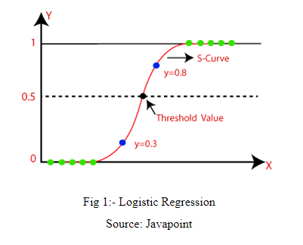
Logistic Regression
Logistic regression is used when the outcome is binary.
Medical application:
Predict hypertension (yes/no)
Logistic regression models log-odds, not probabilities directly.

Slide 31
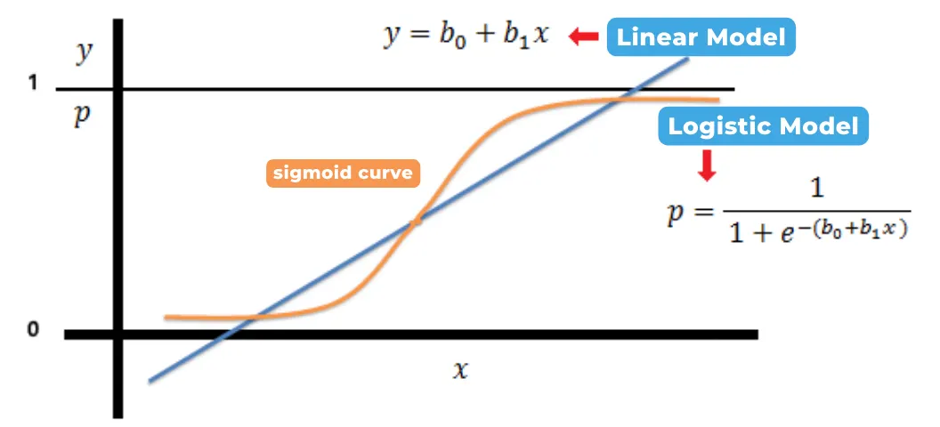
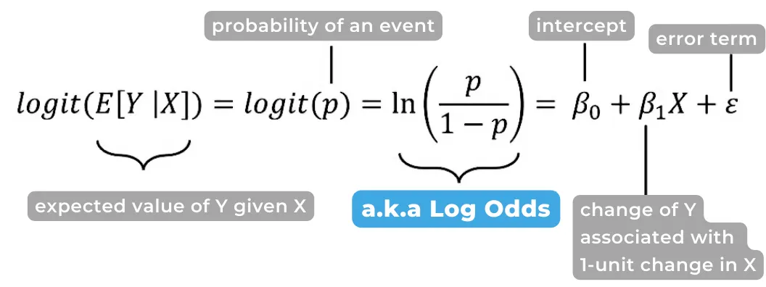
Logistic Regression Equation
Logit model:
log(p / (1 – p)) = β₀ + β₁X₁ + β₂X₂ + ...
Where:
p = probability of the event occurring
This ensures predictions lie between 0 and 1.

Slide 32
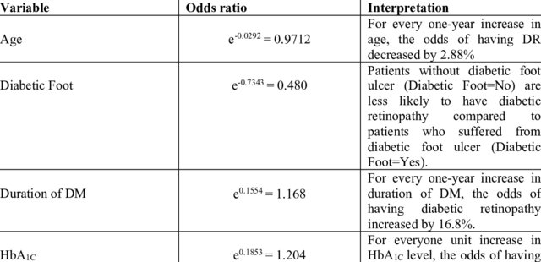
Interpreting Logistic Regression Results
Two interpretations:
Coefficients → Change in log-odds
Odds ratios (e^β) → Multiplicative change in odds
Odds ratio > 1 → Increased odds
Odds ratio < 1 → Decreased odds

Slide 33
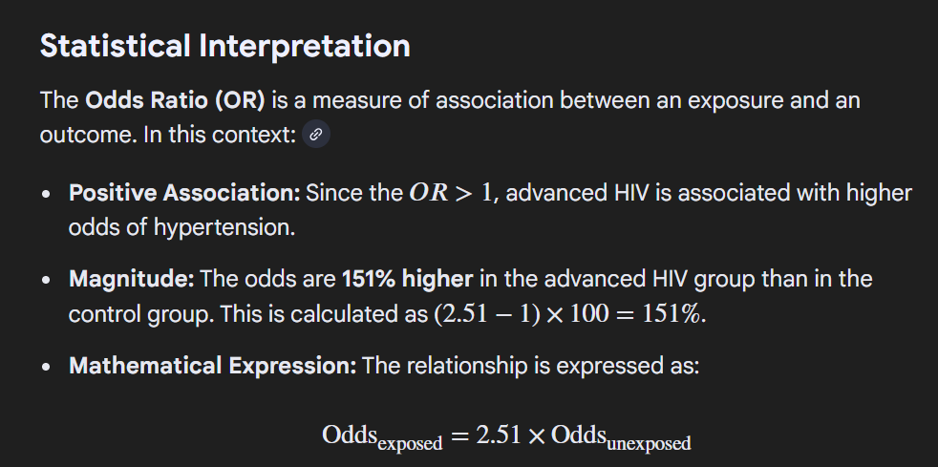
Logistic Regression Example
Advanced HIV status:
Odds ratio = 2.51
Interpretation:
Patients with advanced HIV have 2.5 times higher odds of hypertension compared to others.

Slide 34
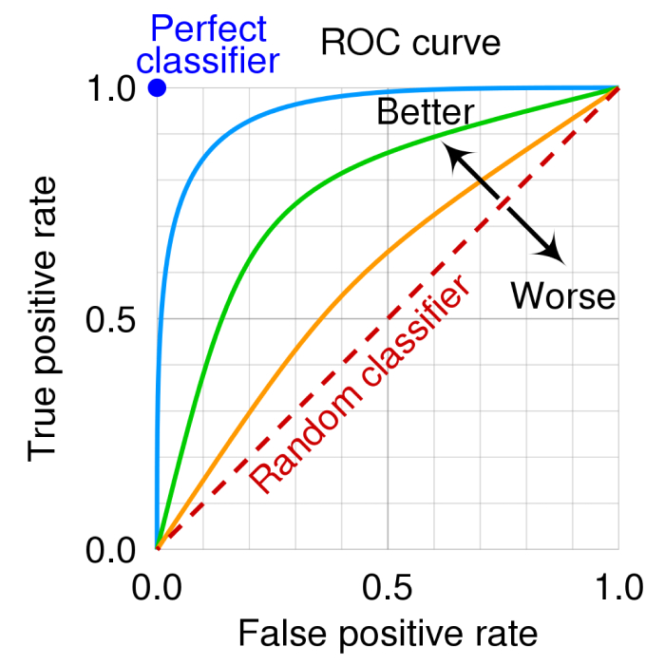
Model Evaluation for Classification
Key metrics for binary outcomes:
Accuracy
Sensitivity (Recall)
Specificity
AUC–ROC
Medical screening prioritize high sensitivity to reduce missed cases.

Slide 35
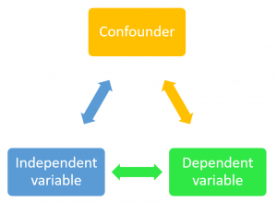
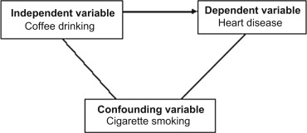
Confounding and Adjustment
Confounding occurs when a third variable distorts the relationship between X and Y.
Example:
Urban clinics appear associated with higher SBP, but age explains the difference.
Solution:
Multivariable regression adjustment.

Slide 36
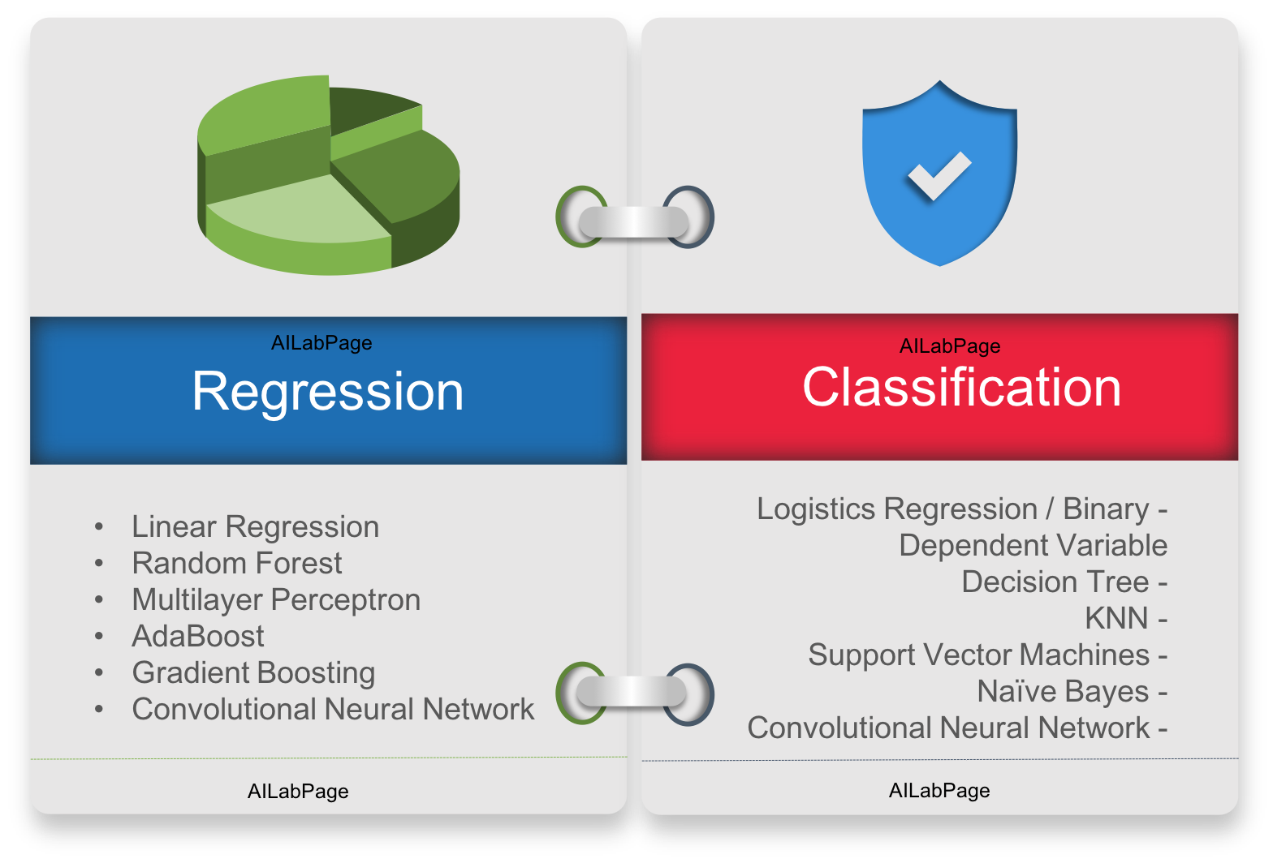
Regression as Machine Learning
Regression models are machine learning algorithms.
Connections:
Linear regression → Linear ML model
Logistic regression → Classification ML model
Neural networks → Stacked regression layers
Understanding regression enables ML mastery.

Slide 37
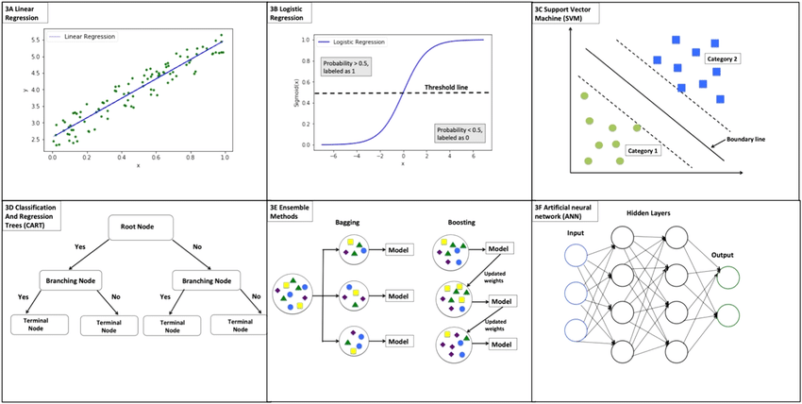
Regression as Machine Learning

Slide 38

Common Statistical Pitfall
Avoid these errors:
Data leakage
P-hacking
Ignoring confounding
Overfitting models
Statistical rigor protects patient safety and model credibility.

Slide 39
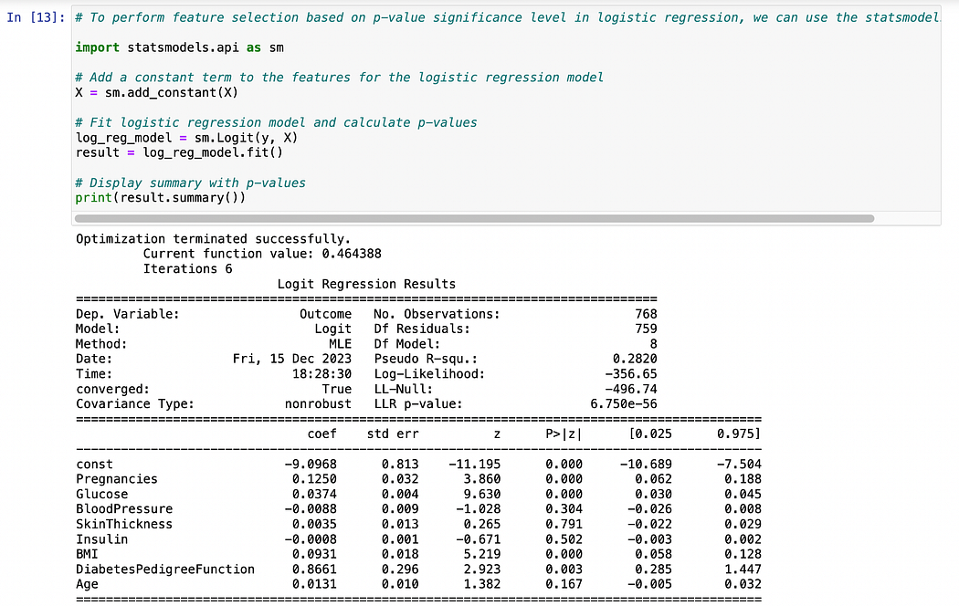
Lab Assignment Overview
Tasks:
Hypothesis testing
OLS regression for SBP
Logistic regression for hypertension
Model evaluation and interpretation
Deliverable:
Python notebook (.ipynb)

Slide 40
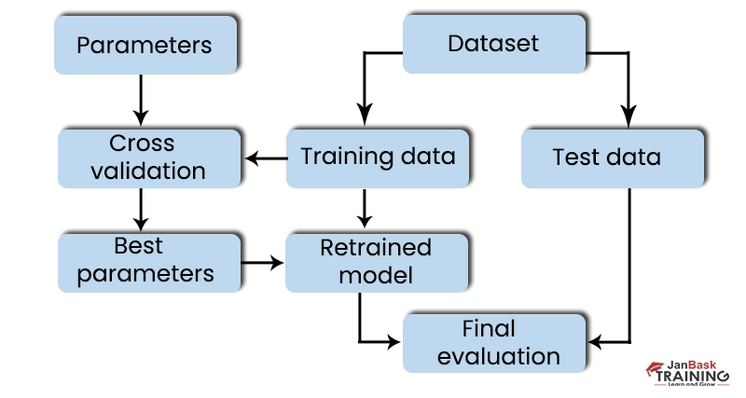
Python Analysis Workflow
Steps:
Load and clean data
Conduct hypothesis tests
Fit OLS regression
Fit logistic regression
Evaluate model performance

Slide 41
Preparing for Week 3 Machine Learning
Before next session:
Complete lab assignment
Review regression concepts
Understand train-test split
Install required Python libraries
Week 3 focuses on scalable ML pipelines.

Slide 42
Conclusion
Key takeaways:
Hypothesis testing guides evidence-based decisions
Regression underpins machine learning algorithms
Statistical literacy enables responsible AI
Healthcare ML requires precision and ethics
Statistics is the foundation of trustworthy machine learning.

